Slide 1
ACCESS-ESM1.5 – ScenarioMIP early results
ACCESS Science Day - September 2019
Roger Bodman, Rachel Law, Tilo Ziehn, Matt Chamberlain, Martin Dix, et. al.
Notes:
View of Mt Buller across Lake Eildon
Acknowledgements

Slide 2
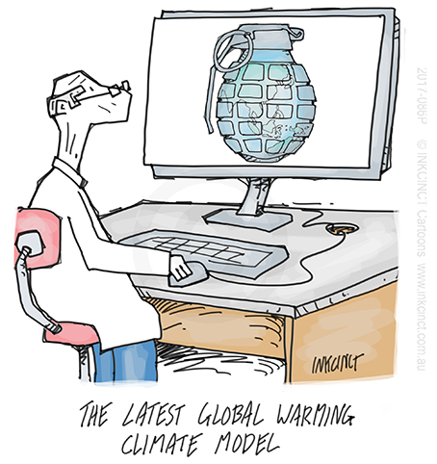
ACCESS-ESM1.5 – ScenarioMIP early results
Outline
Status update
RCPs and SSPs
SSP temps and precip
Carbon cycle

Slide 3
ACCESS-ESM1.5 – ScenarioMIP early results
Status update
DECK
piControl, esm-piControl
abrupt-4xCO2, 1%CO2 and historical (3)
esm-historical (3 WIP (work in-progress))
AMIP (setting up)
SSPs
SSP5-8.5 (3), SSP2-4.5 (3), SSP1-2.6 (2), SSP3-7.0 (WIP),
esm-ssp pending
C4MIP and CDRMIP expts almost all completed
RFMIP pending

Slide 4
SSP prescribed atmospheric CO₂ concentrations
RCPs – Representative Concentration Pathways
SSPs – Shared Socioeconomic Pathways
RCPs: van Vuuren et al (2011), Climatic Change. SSPs: Riahi et al (2016), Global Environ. Change. ScenarioMIP: O’Neill et al (2016), GMD
Notes:
RCP and SSP scenarios – specified co2 atmospheric concentrations
rcp_ch4_n2o_concs_050919.ipynb

Slide 5
SSP prescribed atmospheric CH₄ and N₂O concentrations
Notes:
rcp_ch4_n2o_concs_050919.ipynb

Slide 6
SSP prescribed emissions, CO₂ and SO₂
Notes:
rcps_emms_plot_290819.ipynb

Slide 7
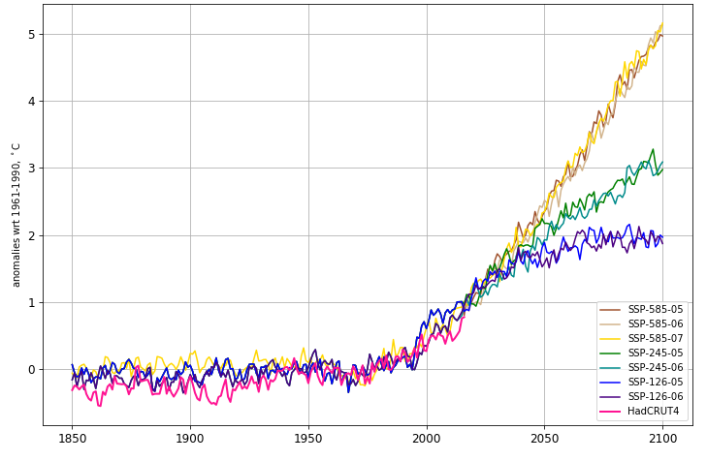
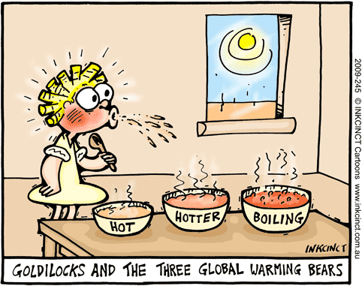
SSP temperature change projections
ºC wrt
1961-1990
Add 0.5ºC for wrt PI

Slide 8
“warming”
“hot”
“hotter”
“boiling”
Change: mean of final decade minus mean of first decade
Historical: 1850 to 2014, SSPs: 1850 to 2100
Notes:
/g/data1/p66/rb4844/my_programs/iris_36/esm_ssp/ssp_pr_anoms_plot_260819.ipynb

Slide 9
SSP rainfall projections
mm/day
Notes:
/g/data1/p66/rb4844/my_programs/iris_36/esm_ssp/ssp_pr_anoms_plot_260819.ipynb

Slide 10
SSP rainfall projections: land-only and ocean-only
(a) Land area
(b) Ocean area
mm/day
Notes:
/g/data1/p66/rb4844/my_programs/iris_36/esm_ssp/ssp_pr_anoms_plot_260819.ipynb

Slide 11
Historical and SSP projected carbon fluxes, land and ocean
GtC
Notes:
/Users/bodmanr/Desktop/ESM_SSP_CBudget/land_ocean_fluxes
esm extended combo fluxes plot 040919

Slide 12
SSP projected carbon fluxes, land and ocean
Notes:
/Users/bodmanr/Desktop/ESM_SSP_CBudget/land_ocean_fluxes
esm ssp combo fluxes plot 040919

Slide 13
Historical carbon budget
flux
‘allowed’ or ‘compatible’ emissions
Prescribed atmospheric increase = Fossil fuel emissions (incl. cement) + wood harvest decay
+ land uptake (incl. LUC) + ocean uptake
Notes:
/g/data1/p66/rb4844/my_programs/iris_36/ESM/CBudget/esm_allowable_ems_060919.ipynb

Slide 14
Carbon budget

Slide 15
SSP1-2.6 carbon budget
Notes:
/g/data1/p66/rb4844/my_programs/iris_36/ESM/CBudget/esm_ssp126_allowable_ems_090919.ipynb

Slide 16
SSP2-4.5 carbon budget
Notes:
module use /g/data3/hh5/public/modules
module load conda/analysis3
source activate analysis3-19.04
jupyter notebook /g/data1/p66/rb4844/my_programs/iris_36/ESM/CBudget/esm_ssp245_allowable_ems_090919.ipynb

Slide 17
SSP5-8.5 carbon budget
flux
Notes:
“allowed” or “compatible” emissions
jupyter notebook /g/data1/p66/rb4844/my_programs/iris_36/ESM/CBudget/esm_ssp585_allowable_ems_090919.ipynb

Slide 18
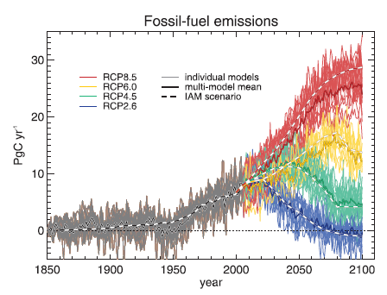
Carbon budget summary
SSP2-4.5 FFE
SSP2-4.5 mode
SSP1-2.6 FFE
SSP1-2.6 model
Jones et al (2013) JClim Fig. 5
Notes:
models may have larger climate-carbon feedbacks than IAMs, also land use change uncertainties and how/if they are modelled
concentrations driven framework means fully interactive climate-carbon feedbacks not effective
module use /g/data3/hh5/public/modules
module load conda/analysis3
source activate analysis3-19.04
jupyter notebook /g/data1/p66/rb4844/my_programs/iris_36/ESM/CBudget/esm_ssp_allowable_ems_combo_100919.ipynb

Slide 19
SSP1-2.6 zonal mean land flux – 2 realisations
Notes:
jupyter notebook /g/data1/p66/rb4844/my_programs/iris_36/ESM/CBudget/esm_ssp126_zonal_nee_plot_100919.ipynb

Slide 20
SSP2-4.5 zonal mean land flux – 3 realisations
Notes:
jupyter notebook /g/data1/p66/rb4844/my_programs/iris_36/ESM/CBudget/esm_ssp245_zonal_nee_plot_100919.ipynb

Slide 21
SSP5-8.5 zonal mean land flux – 3 realisations
Notes:
jupyter notebook /g/data1/p66/rb4844/my_programs/iris_36/ESM/CBudget/esm_ssp585_zonal_nee_plot_100919.ipynb

Slide 22

End

